Slide 1
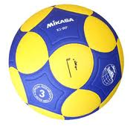
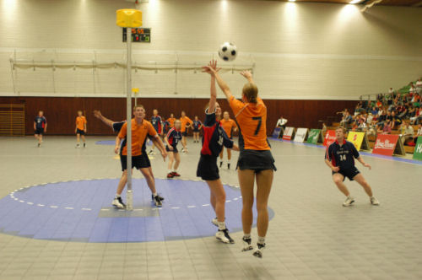
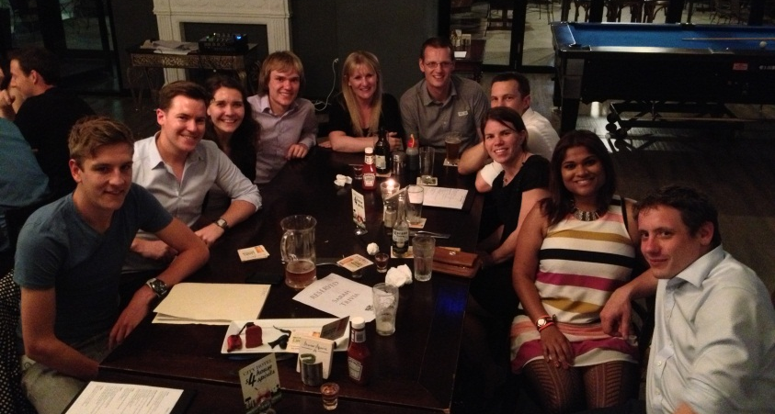
Korfball
has landed in Sydney
Heard of Korfball? Whether you have or not, come along and join in with the newest korfball club in Australia – The Sydney City Redbacks Korfball Club.
Team sport
Fast paced
Mixed-sex teams
4 girls per team
4 guys per team
Attack and defend
Similar to netball and basketball
Anyone welcome
Fun training sessions
Regular socials
Tournaments across Australia
Training time: Saturday, 10:00am-11:30am
Location: EORA Fitness, Redfern
Find us on Facebook: Sydney City Redbacks Korfball Club
Contact: sydneykorfball@gmail.com

